Slide 1
Classification of various Attacks.

Slide 2
Objectives
1. Introduction
2. Classification of Attacks
Behavior based attacks (Active or Passive)
Location based attacks (Internal or External)
Layer based attacks

Slide 3
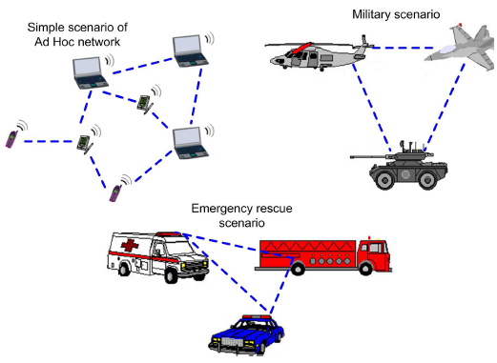
1. Introduction
Mobile Ad-hoc network is a temporary network of mobile nodes;
Mobile nodes communicate with each other through wireless links with no fixed infrastructure & no central control.
Each mobile node acts as both a router & host.
Nodes within each other's radio range communicate directly, while those that are far apart use other nodes as relays.
Minimal configuration & quick deployment make them suitable for emergency situations like war, emergency medical situations etc.
Fig 1: MANET and its applications

Slide 4
MANETs Operation : After one of the nodes is configured as a gateway, the entire network is connected to an external network like Internet.
1. Introduction(cont.)
Internet
C
B
D
E
E
A
Gateway
F
Fig 2: MANETs Operation

Slide 5
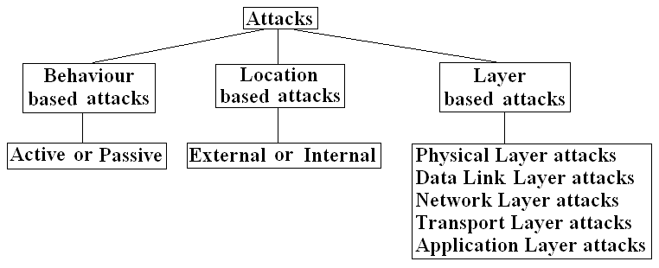
2. Classification of Attacks
Lack of any central administration & due to security vulnerabilities of the routing protocols makes MANET more vulnerable to attacks. Such attacks can be categorized as given below
Behavior based attacks i.e. Passive or Active attack
Location/Source based attacks i.e. Internal or External
Layer based attacks
Fig 3: Classification of attacks

Slide 6
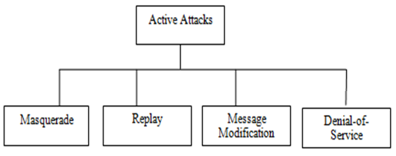

2. Classification of Attacks (Cont.)
a) Behavior based attacks (Active or Passive)
Active attack: Those attacks that attempt to alter, inject, delete or destroy the data being exchanged in the network.
Intention to damage network or disrupt the network operations
Modifies the contents of the packets
Easier to handle as detecting modifications is not difficult.
Types of active attacks are: Fabrication or masquerading attacks, message modifications, message replays and DOS attacks.
Fig 4: Active Attack
Fig 5: Types of Active attacks

Slide 7
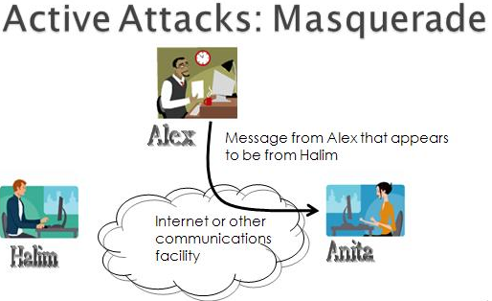
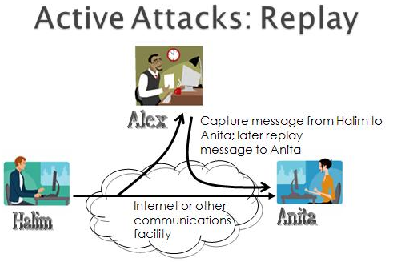
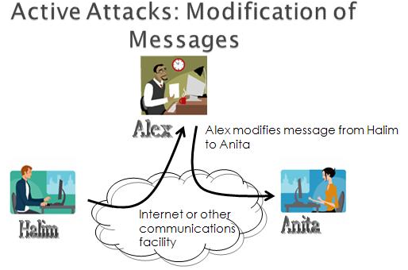
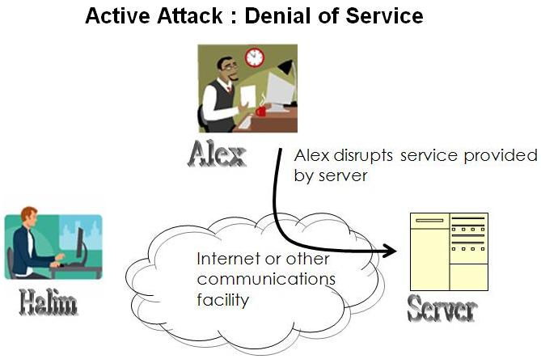
2. Classification of Attacks (Cont.)
Fig 6: Active Attacks : Masquerade, Replay, Modification of Message or DOS

Slide 8
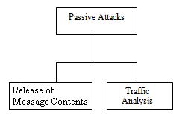

2. Classification of Attacks (Cont.)
Passive attack : Those attacks which attempt to learn or make use of information from the system but does not affect system resources.
  No intention to damage the network & network operations.
  Does not modifies the contents of the packets
  Difficult to handle as modifications cannot be detected easily.
  Types of Passive Attacks: Release of message contents and Traffic analysis.
Fig 7: Passive Attack
Fig 8: Types of Passive attacks

Slide 9
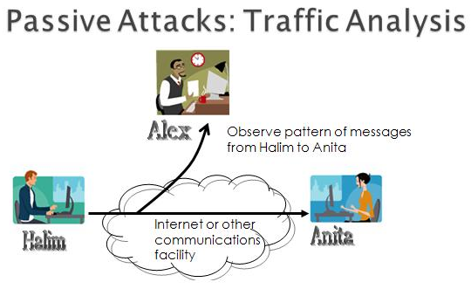
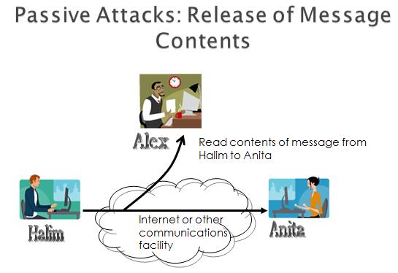
2. Classification of Attacks (Cont.)
Fig 9: Passive attacks : Traffic Analysis & Release of Message Contents.

Slide 10
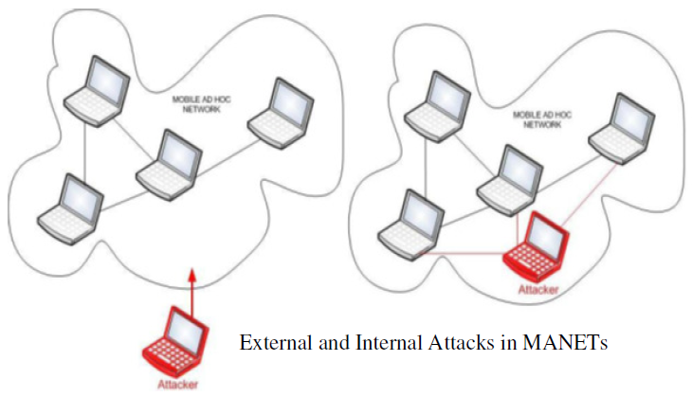
2. Classification of Attacks (Cont.)
b) Location based attacks (External or Internal)
External attack: Those attacks which are carried out by nodes or group of nodes that do not belong to the network.
    Such attacks send fake packets in order to interrupt the performance of the network.
    Can be avoided by implementing firewall and encryption techniques.
Internal attack : Those attacks which are carried out by nodes or group of nodes that are actually part of the network.
    Either by acting as a impersonated node or compromising an existing node.
    More severe and difficult to detect than external attacks.
Fig 10: External & Internal Attacks

Slide 11
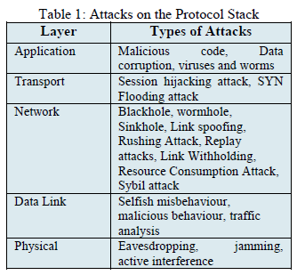
2. Classification of Attacks (Cont.)
c) Layer based attacks
Attacks at Physical Layer
Attacks at Link/MAC Layer
Attack at Network Layer
Attack at Transport Layer
Attack at Application Layer

Slide 12
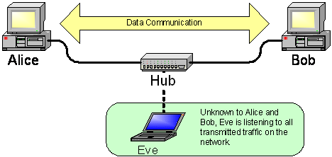
2. Classification of Attacks (Cont.)
i) Attacks at the Physical Layer
The attacks on physical layer are hardware oriented.
They need help from hardware sources to come into effect.
Types : eavesdropping, interference and jamming.
Eavesdropping
reading of messages or conversations.
The main aim of such attacks is to obtain the confidential information such as private key, public key or passwords.
Example : Sniffers (a piece of software that grabs all of the traffic flowing into and out of a computer attached to a network)
Fig 11: Eavesdropping

Slide 13
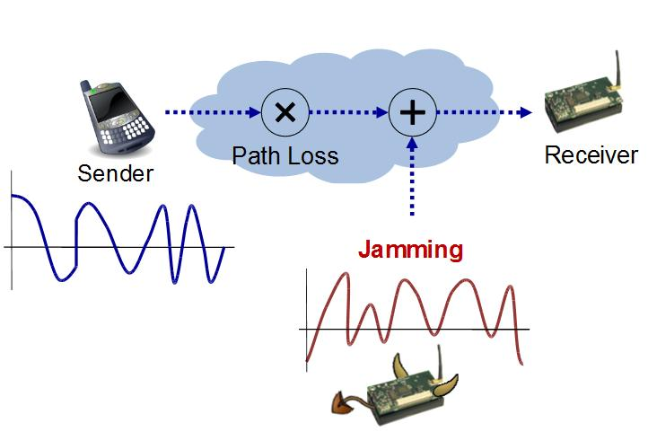
2. Classification of Attacks (Cont.)
Jamming and Interference
Special type of DOS attack.
a radio signal can be jammed or interfered, which causes the message to be corrupted or lost.
A malicious node keeps monitoring the wireless medium in order to find out the frequency at which the receiver node is receiving signals from the sender.
The attacker then transmits signals using the same frequency to send data to the receiver thereby disrupting communications.
Frequency hopping is used to overcome jamming attacks.
Fig 12: Jamming & Active Interference

Slide 14
2. Classification of Attacks (Cont.)
ii) Attacks at Link/MAC Layer
Selfish Misbehavior of Nodes:
Directly affects the self-performance of nodes.
Does not interfere with the operation of the network.
Selfish nodes may refuse to take part in the forwarding process.
Dropping packets intentionally in order to conserve the resources.
Malicious behavior of Nodes:
Purpose of malicious node is to disrupt the network operation.
Types: DOS & Misdirecting traffic
DOS: an attacker attempts to prevent legitimate users from accessing information or services. Example: Flooding, disrupt connections
Misdirecting traffic: A malicious node advertises wrong routing info like fake route request or fake error messages.
Traffic Analysis :
Confidential information about network topology can be derived by analyzing traffic patterns.
Reveal information like: Location of nodes, Network topology and roles played by source nodes and destination nodes.

Slide 15
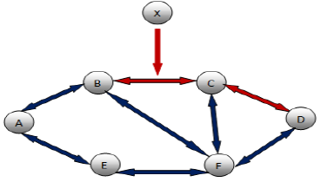
2. Classification of Attacks (Cont.)
iii) Attacks at Network Layer
The basic idea behind network layer attacks is to inject itself in the active path from source to destination or to absorb network traffic.
Examples: Routing attack, Black hole attack, Rushing attack, Worm hole attack, Sink hole attack, Link Spoofing attack, Sybil attack and Byzantine attack.
Routing attack: Attack against the Routing and Path Selection to disrupt the operation of the network.
As shown in the figure below: The malicious node X can absorb important data by placing itself between source A and destination D.
X can also divert the data packets exchanged between A and D, which results in significant end to end delay between A and D.
Fig 13: Routing attack

Slide 16
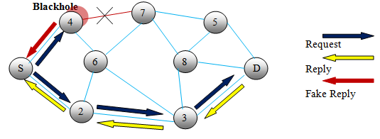
2. Classification of Attacks (Cont.)
Black hole Attack: In this type of attacks, malicious node claims having an optimum route to the destination node.
Route Requests (RREQs), Route Replay (RREPs), Route Errors (RERRs) are control messages used for establishing a path to the destination.
In fig. below when source node S wants to send data to destination node D, it initiates the route discovery process by sending RREQ Packets.
The malicious node 4 when receives the route request, it immediately sends response by RREP to the source.
Malicious node 4 advertises itself in such a way that it has a shortest route to the destination.
If reply from node 4 reaches first to the source S, then the source node S ignores all other reply messages & begin to send packet via route node 4.
Fig 14: Black hole attack

Slide 17
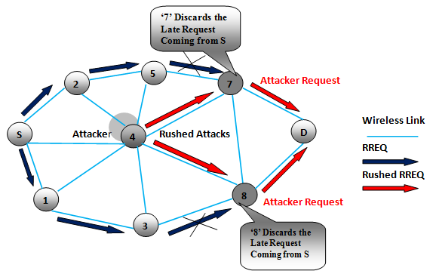
2. Classification of Attacks (Cont.)
Rushing attack: When a compromised node receives a route request packet from the source node, it floods the packet quickly throughout the network before other nodes.
In fig. below, the node 4 represents the rushing attack node.
The rushing attack of compromised node 4 quickly broadcasts the route request messages to ensure that the RREQ message from itself arrive earlier than from other nodes(in this case i.e. from S.
When neighboring node of D i.e. 7 and 8 when receive the actual (late) route request from source, they simply discard the request.
So in the presence of such attacks S fails to discover any useable route or safe route without the involvement of attacker.
Fig 15: Rushing Attack

Slide 18
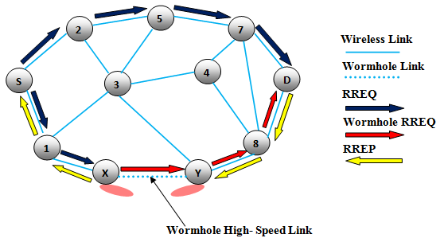
2. Classification of Attacks (Cont.)
Worm hole Attack: In wormhole attack, malicious node receive data packet at one point in the network and tunnels them to another malicious node. The tunnel exist between two malicious nodes is referred to as a wormhole.
In fig. below, the nodes X & Y are malicious node that forms the tunnel.
The source node S when initiate the RREQ message to find the route to node D destination node.
The immediate neighbor node of source node S, namely 2 and 1 forwards the RREQ message to their respective neighbors 5 and X.
The node X when receive the RREQ it immediately share with it Y and later it initiate RREQ to its neighbor node 8.
Due to high speed link, it forces the source node to select route <S-1-8-D> for destination.
Fig 16: Wormhole attack

Slide 19
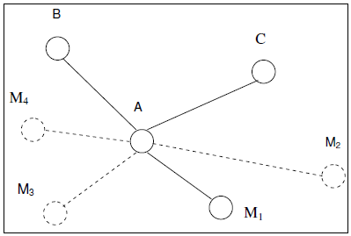
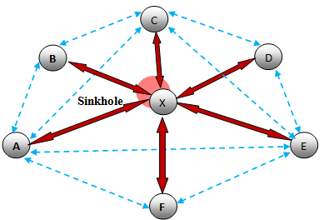
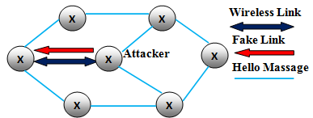
2. Classification of Attacks (Cont.)
Sink hole Attack: In sinkhole Attack, a compromised node or malicious node advertises wrong routing information to produce itself as a attractive specific node and receives whole network traffic.
Link Spoofing Attack: In Link spoofing attacks, a malicious node broadcasts fake route information to disrupt the routing operation.
Sybil Attack: In this attack, a malicious node produces itself as a large number of nodes instead of single node. Sybil attacker may generate fake identities to represent multiple identities for a malicious node. In Fig 19, A is connected with B, C and the malicious node, M1. If M1 represents other nodes M2, M3 and M4 (e.g. by using their secret keys) this makes A believe it has 6 neighbors instead of 3.
Fig 17: Sink Hole Attack
Fig 18: Link Spoofing Attack
Fig 19: Sybil Attack

Slide 20
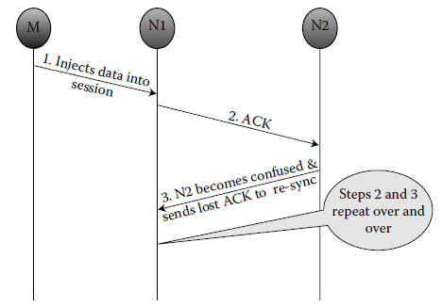
2. Classification of Attacks (Cont.)
iii) Attacks at Transport Layer
Session Hijacking The attacker in a session hijacking scenario exploits the unprotected session following its initial setup and it tries to collect secure data. E.g. of session hijacking attack is TCP–ACK storm Problem.
In fig. below, nodes N1 and N2 have established a TCP connection. An attacker M spoofs the IP address of N2 and injects data into the session of node N1.
N1 acknowledges the receipt by sending an ACK packet to node N2.
As N2 notices a different sequence number in the received ACK packet from N1, it reissues its last ACK packet to N1 in order to resynchronize.
This process repeats over and over, leading to an ACK storm.
Fig 20: Session Hijacking : TCP-ACK storm

Slide 21
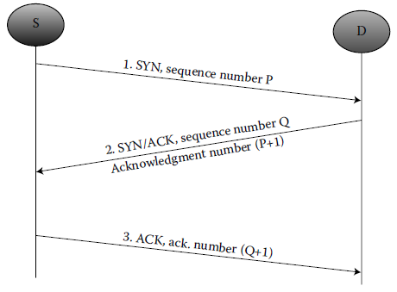
2. Classification of Attacks (Cont.)
iii) Attacks at Transport Layer
SYN Flooding Attack: Those attacks in which attacker creates a large number of half opened TCP connection with victim node. TCP connection between two communicating parties is established through completing three way handshakes, described in the fig. below
Step1: Node S sends a SYN packet with a seq. number P to Node D.
Step2: Node D transmits to S, a SYN/ACK message, including its own sequence number Q & acknowledgment number P+1.
Step3: S issues an ACK message (with ack. number Q+1) to D.
Fig 21: SYN Flooding Attack

Slide 22
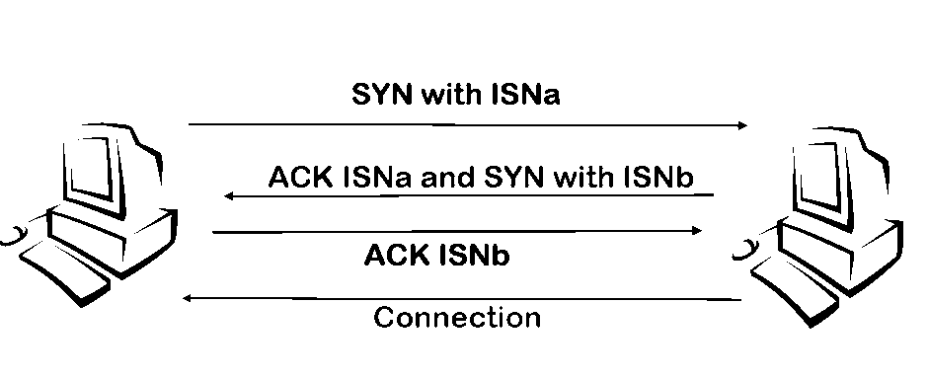
2. Classification of Attacks (Cont.)
iii) Attacks at Transport Layer
A SYN flood is a form of denial-of-service attack in which an attacker sends a succession of SYN requests to a target's system in an attempt to consume enough server resources to make the system unresponsive to legitimate traffic.
Fig 22: SYN Flooding Attack

Slide 23
2. Classification of Attacks (Cont.)
iii) Attacks at Application Layer
Repudiation Attacks: refers to a denial of participation in the communication. Example of repudiation attack on a commercial system: a selfish person could deny conducting an operation on a credit card purchase or deny any on-line transaction, which is a repudiation attack on a commercial system.
Malicious code attacks: Malicious code attacks include, Viruses, Worms, Spywares, and Trojan horses, can attack both operating system and user application. These malicious programs usually can spread themselves through the network and cause the computer system and networks to slow down.

Slide 24
Thanks

